Slide 1
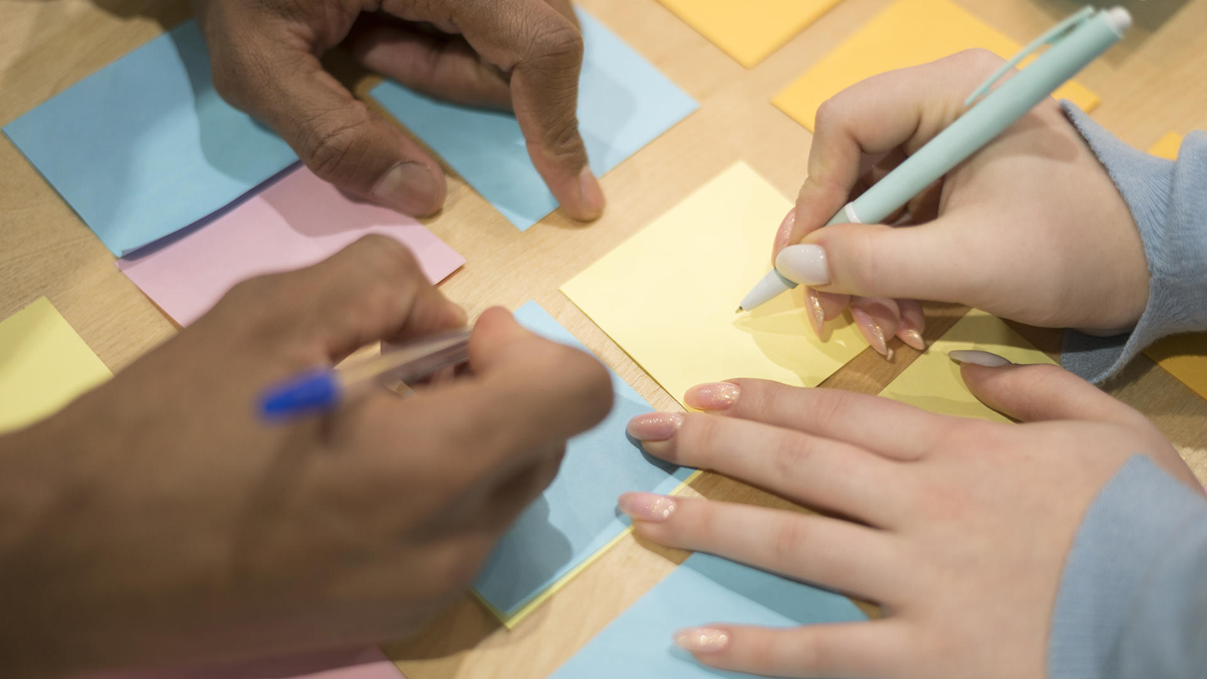
MAR6833: Final Project Report
Presentation Recording
Group 13: Gabrielle Guerrero, Zoe Hays, Jonathan Ortega, Marielle Paz, Claudia Vega
Notes:
Presentation Recording: https://drive.google.com/file/d/14RbLCzreAZzZDUBMkGXzPwdayCkfWx2C/view?usp=sharing

Slide 2
Agenda
01
03
02
04
Opportunity Identification
Prototype
Concept Testing
Go/ No-Go

Slide 3

01
Opportunity Identification
Notes:
First we will be speaking about the opportunity identification.

Slide 4
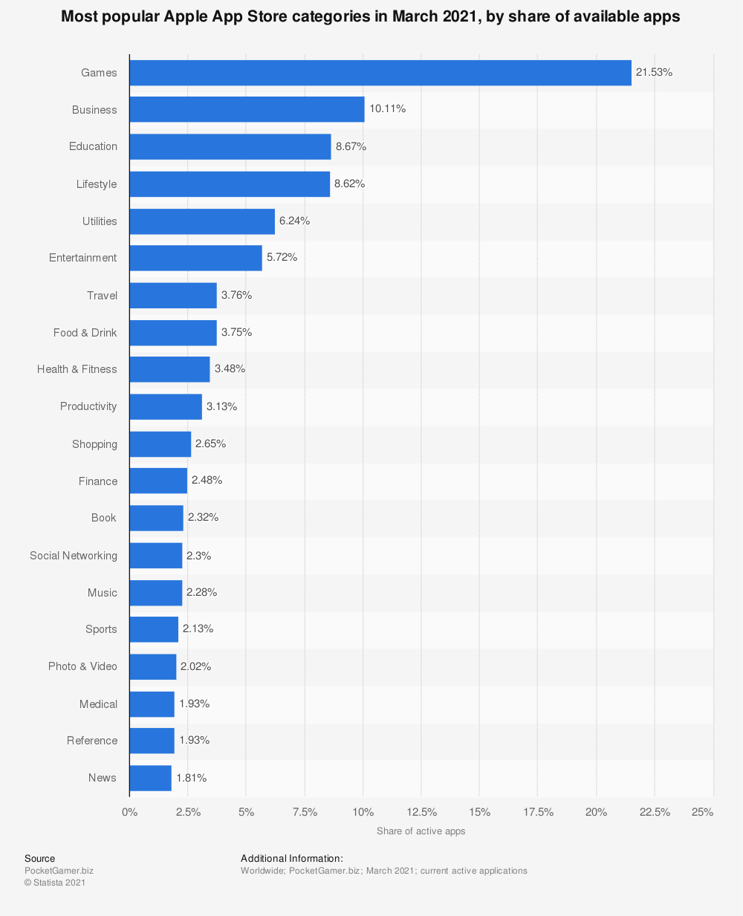
Market Growth
& Expansion
There is opportunity in this market as seen by the growth in the space.
Currently the space is not very commoditized because the availability of planners have made it a utility
New innovations for planners include:
The ability for the apps work with other features and apps on your phone
Customized notifications and smart reminders
Habit Tracking
Notes:
Current growth in the organization app space is positive. Productivity apps are the 10th most popular app store category. Utility apps which also have organization apps that fall under that category, are the 5th most popular on the app store.
However, there is very little distinguishing one planner from another, on top of that there is an overabundance amount of planning apps.
Planners are therefore not commoditized and represent an opportunity to do so with unique design.
New innovations include the ability for apps to work with other features in your phones, customized notifications that the apps create by scanning your communications and habit tracking which has done helping people visualize their progress, making the experience more meaningful to the user.

Slide 5
Survey and Empathic Design
Notes:
I will now be guiding you through the first observations and interpretations of our customer focus group consisting of college and postgraduate students ages 18 through 26 years old.
Our observations were led by an initial survey of over 32 respondents and empathic designs gathered across study rooms, coffee shops, and libraries that measured individuals’ productivity and organizational tool preferences.
Additionally we used customer reviews to help understand consumer behavior through best, mid-range, and worst rated reviews.

Slide 6
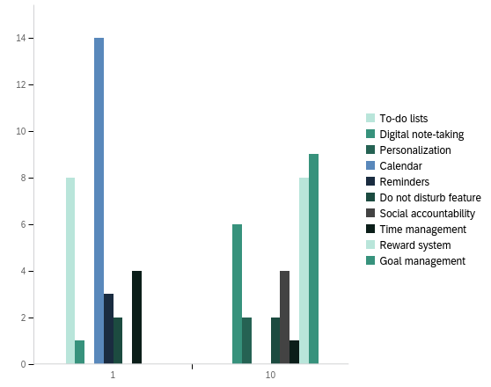
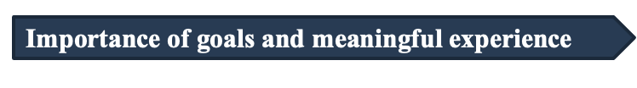
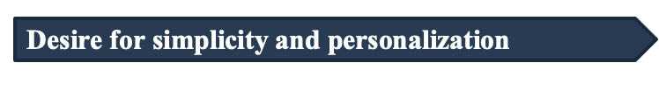
Observations
People with definitive/tangible lists of things to do were actively working to complete it and would reference their list occasionally.
Individuals most efficient working environment and resources are tailored to their specific needs and simple to use.
#1 ranked attributes and #10 ranked attributes
Notes:
Through the survey results, we uncovered that the majority of respondents using productivity tools use either a digital calendar, a planner, google tools, or a combination of those.
The main dislike was having different lists on different apps that do not connect.
The most important is a calendar feature, and the least important is digital note taking.
From the survey responses and in person observations we saw the importance of setting goals and the need for a meaningful experience. People seem to work best with a definitive to do list that also helped serve as reminder to complete it, with the ability to go back to past lists occasionally.
Our observations showed that customers are looking for comprehensiveness and personalization above all within organizational apps to help their work environment overall

Slide 7
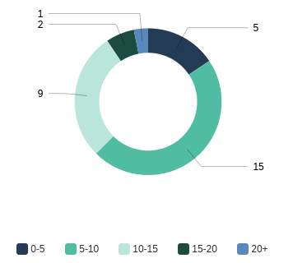
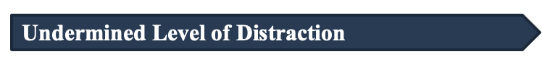
Observations
Most students used their phones after 16-35 minutes of studying, 5-20 minutes before going back to their studies, and more than 15 minutes before starting.
# of times respondents pick up their phone during 1 hour of studying
Notes:
Following these observations we also found that students tend to undermine the level of distraction experienced while studying alone or with others.
The pie chart shows the amount of times respondents pick up their phone during one hour of studying. While in the survey most students believe they pick up their phone between five and ten times, we observed students would pick up the phone from 10-15 times within the first hour of studying.
Most students used their phones after 16 to 35 minutes of studying, 5 to 20 minutes before going back to studies, and more than 15 minutes before actually starting.
We believe this misinterpretation between the survey and our personal observations is caused by the enjoyment the phone brings to people. When students were enjoying themselves through the phone, time moved quicker for them; hence they don’t realize the level of time consumption it causes.

Slide 8
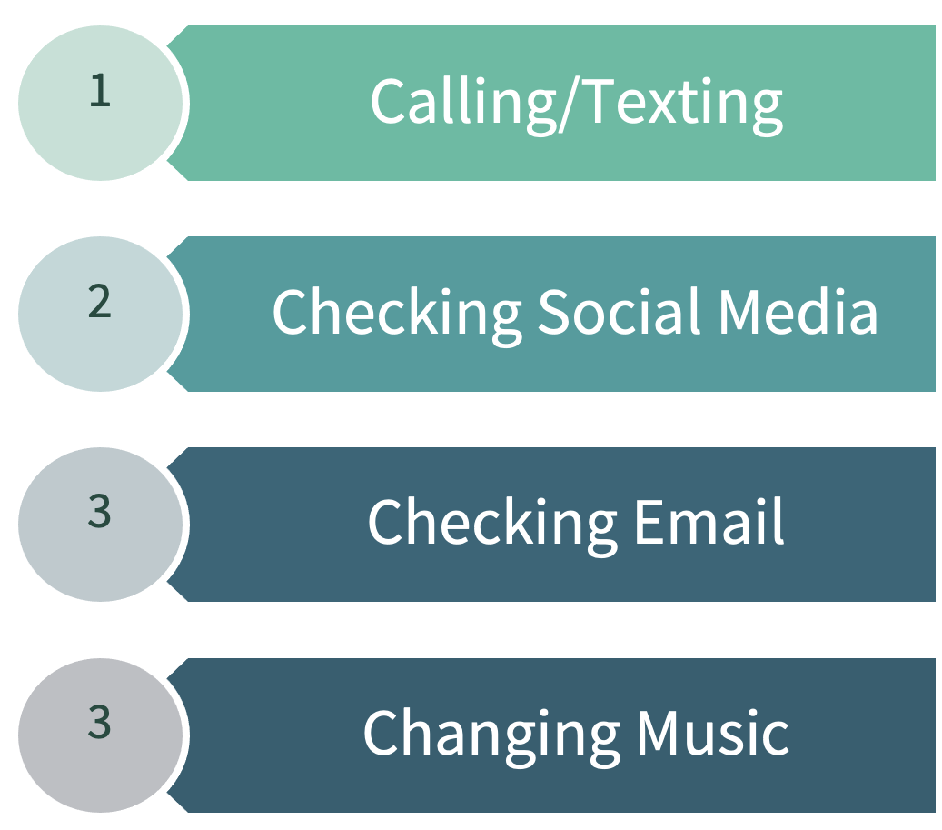
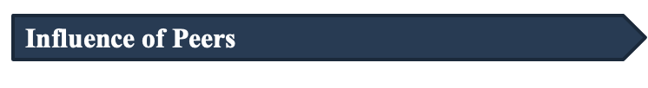
Observations
Those studying with friends would lose concentration more easily and engage in conversation, subsequently stopping studying.
Top activities when picking up phone while studying
Notes:
Hand in hand with the level of distraction, the survey responses showed the top activities students did when picking up their phone while studying were distracting activities that took away from their studies.
We also saw the effect of peer influence. Those studying with friends would lose concentration more easily and engage in conversation, causing them to stop studying.

Slide 9
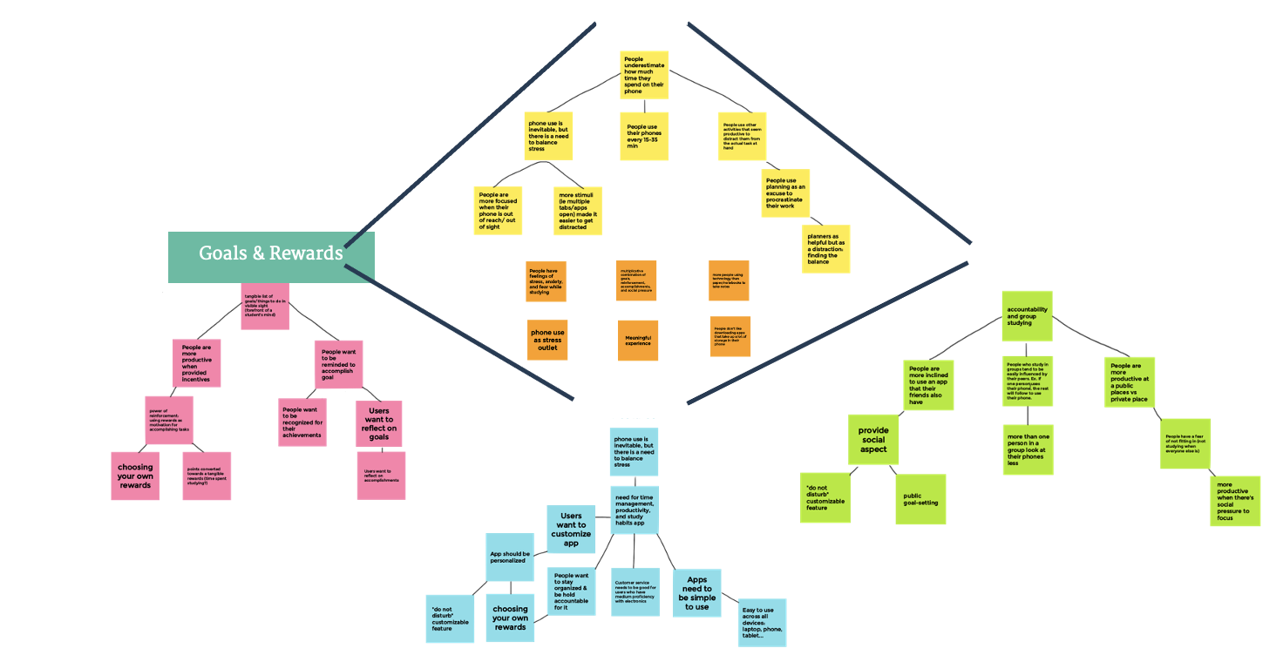
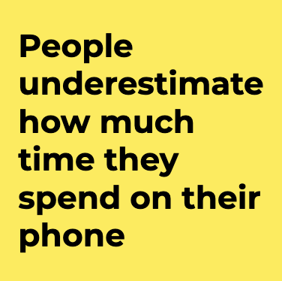
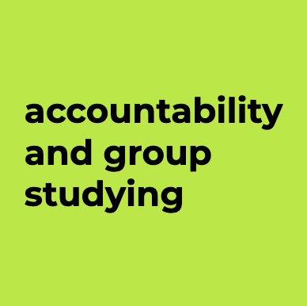
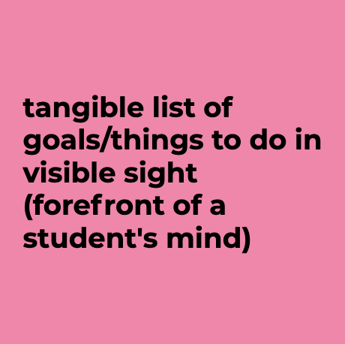
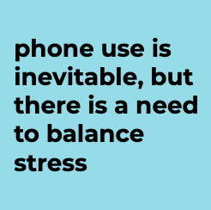
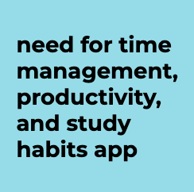
Affinity Diagram
Notes:
To help us organize and understand our qualitative data, we created an affinity diagram.
We wrote down each piece of relevant information on sticky notes and moved them next to correlated notes to form informal groups.
Within each group, we organized sticky notes into a hierarchy of thought. The emerging groups we found included goals & rewards, phone use, the social aspect, and potential app features.
We put all four of those groups together to form a more cohesive hierarchy and looked at the Affinity Diagram we created to help us identify unmet customer needs in our category.

Slide 10
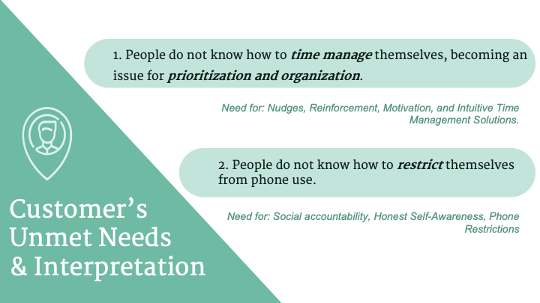
Notes:
We concluded people do not know how to time manage themselves, which becomes an issue for prioritization and organization.
Individuals need an app that not only helps with the organization through lists and visuals of all tasks, but through reminders, nudges, and reinforcements that motivates them to work and become aware of distracting external factors and the lack of self-control towards these.
There is a need for an app that helps these group of studying and working individuals to form a habit of productivity through deep and dedicated concentration.
The second unmet need we found was that people do not know to restrict themselves from phone use.
Through the comparison in results found by the survey and empathic design we saw that students are unaware and not honest with themselves on the amount of time they spend distracted my external factors such as phone usage.
This is clear in the way students behave and carry themselves while studying by themselves or with others.
This shows a need to turn phones as source that gives into productivity rather than take away and a need for social accountability while in social settings.

Slide 11
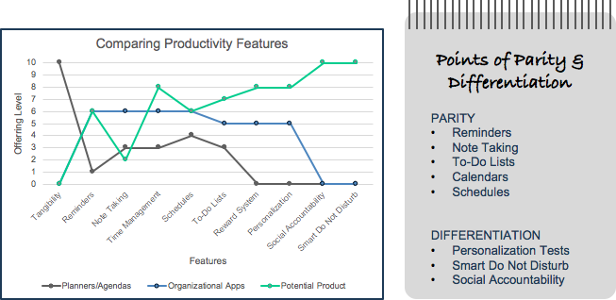
Strategy Canvas
Notes:
One of the most important aspects of the opportunity identification process was drawing and analyzing our strategy canvas.
Looking at the graph, the green line represents our potential product, the blue line symbolizes existing organizational phone apps, and the grey line represents planners/agendas.
Where the lines overlap represents the points of parity of our potential product like reminders and note taking. Where the green line breaks off and rises on the right demonstrates our product’s points of differentiation which include personalization tests, Smart Do Not Disturb, and social accountability features.

Slide 12

02
Concept Testing
Notes:
After identifying the opportunity in the category, we decided to test concepts that could solve the unmet consumer needs we found.

Slide 13
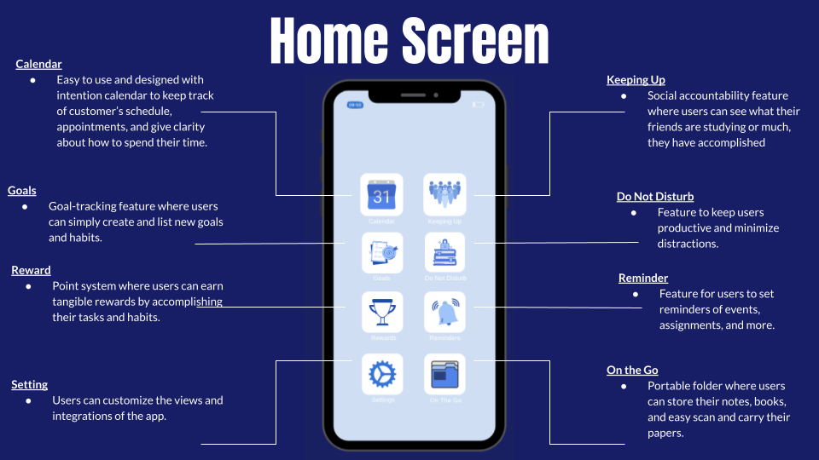
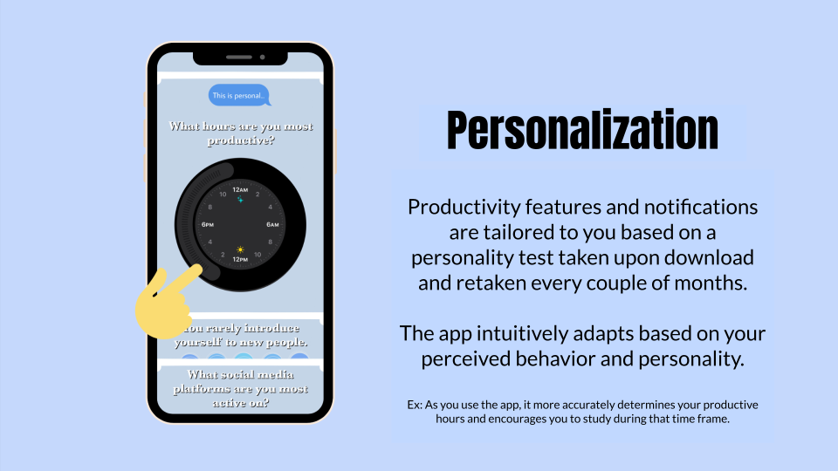
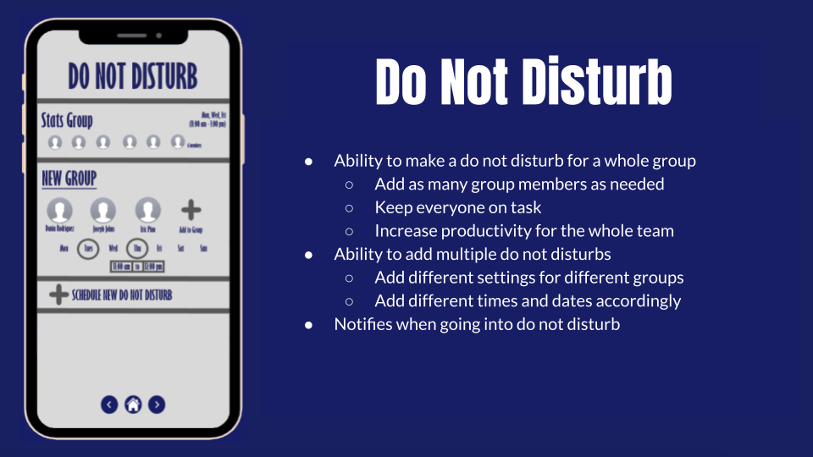
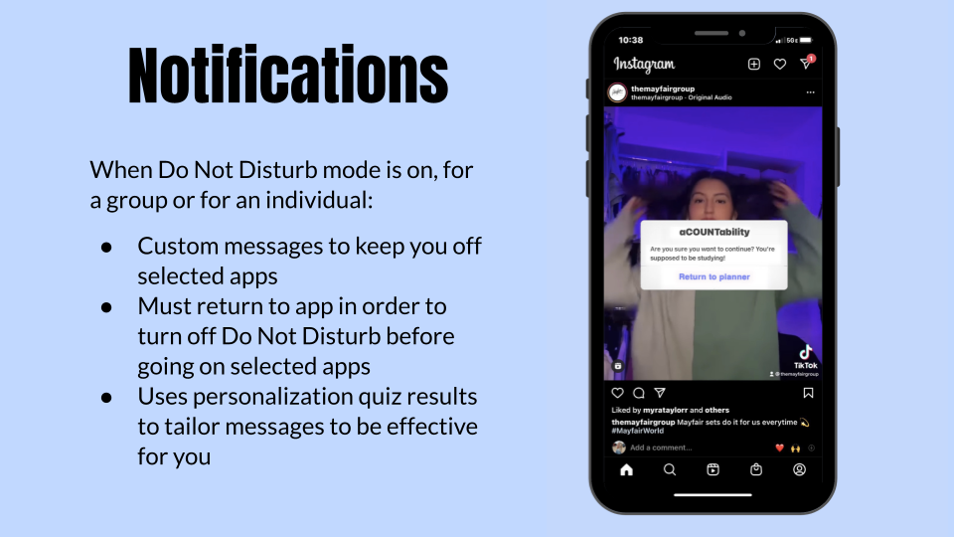
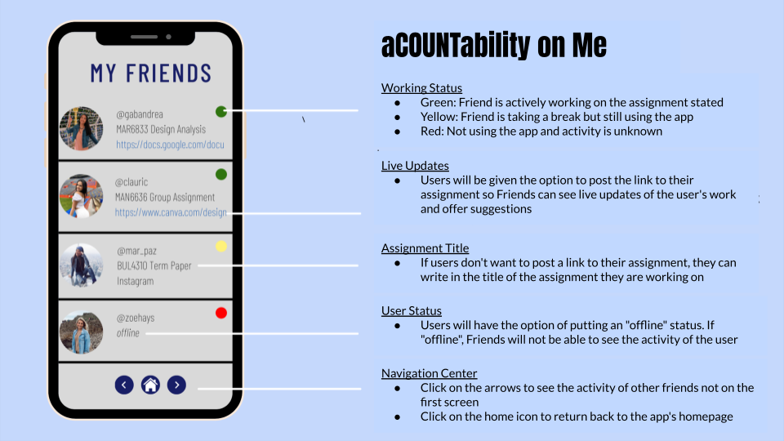
Original Concept Prototype
2 Interview Rounds
Concept Testing
Attribute Dependency
Phone use (with our app) encourages time management and organization, rather than distracting users.
Survey
N = 40
Original Concept Prototypes:
Notes:
We used attribute dependency for our inventive template, finding that we could create dependency between phone use and time management, so that using your phone actually kept you on track to prioritize tasks rather than distracting you. Once identifying features we wanted to include, we made our first original concept prototype, seen here, before launching into in-house concept testing with interviews. The interview insight we received was then used to improve our next prototype, which we then tested with a survey group.

Slide 14
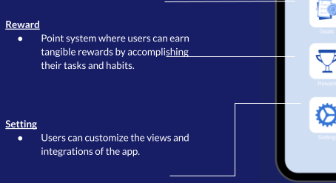
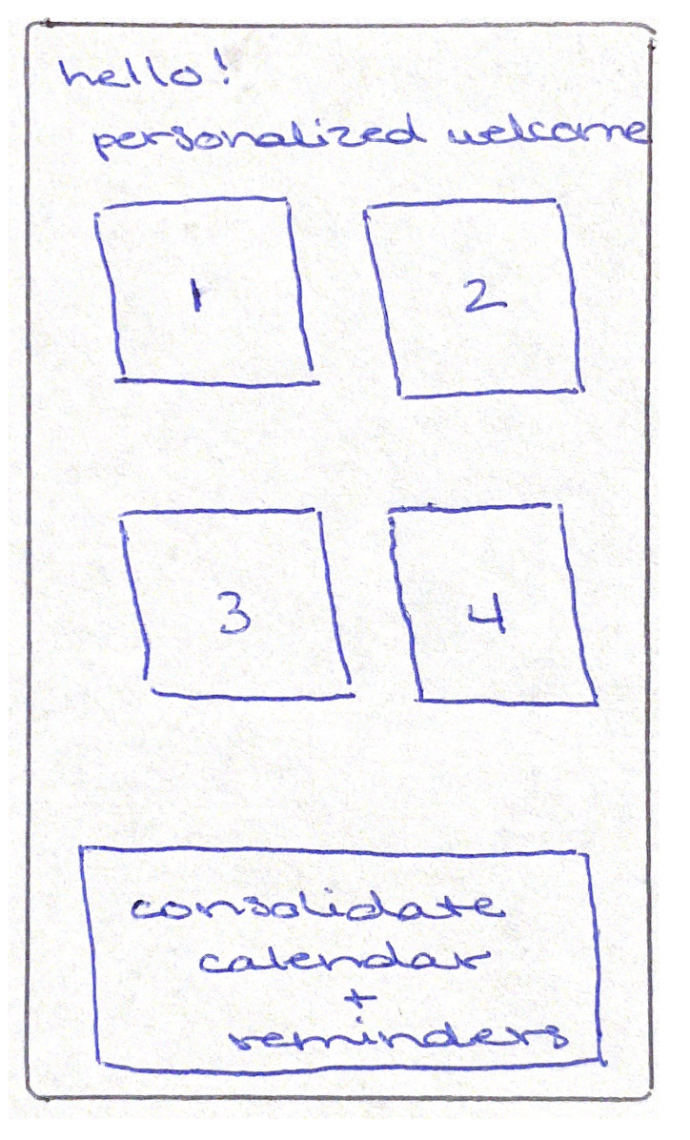
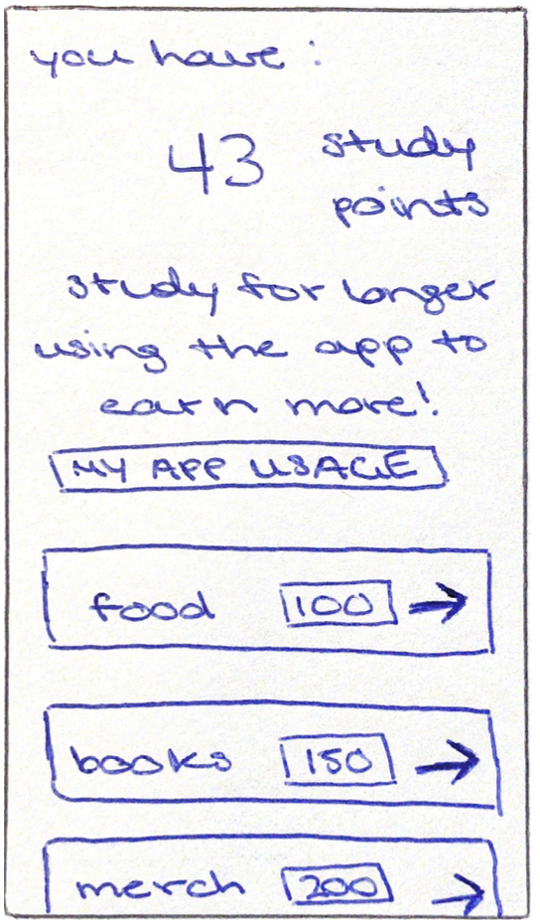
Concept Testing + Interview Insights
1
Too Many Features! Home screen too busy.
2
Expand on the Rewards System!
Original Concept Prototype:
Solution: Emphasize and include only 4 differentiating features.
Solution: Add a rewards prototype slide, including what can be won.
◦ Focus on (1) personalization, (2)
rewards, (3) do not disturb, and (4)
social accountability.
◦ Consolidate calendar & reminders
◦ How to earn: points per minute and
user’s personal points
◦ List redeemable prizes: food,
textbooks, university specials
◦ Potential funding + partnerships
Notes:
Our interviews led us to four key insights. First, our app concept offered too many features and was too busy. Based on interview recommendations, we chose to focus on our four main differentiating features: personalization, rewards, do not disturb, and social accountability, which led us to redesigning our home screen and prototype presentation.
Secondly, interviewees inquired about the Rewards System, which we had not believed would be as great of value until the interviews consistently asked us to expand on rewards. So, we added Rewards to our prototype and considered it one of our 4 differentiating features. We included how the point system works and the prizes which users could win.

Slide 15
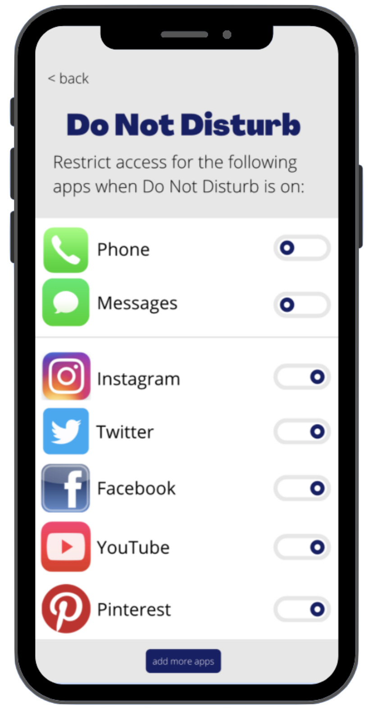
Concept Testing + Interview Insights
3
What happens when the notification pops up?
4
Loved ease of reading and design of this slide.
Original Concept Prototype:
Other Insights:
(1) Social aspects were the most unique application aspect, with social accountability as a key differentiator.
(2) Calendar and reminders can be consolidated and must be compatible across accounts, such as iPhone and Outlook calendars.
(3) Willingness to pay must have trialability. The app could use a tiered subscription strategy.
Solution: Add prototype interface to expand on notification value offering.
Solution: Implement line design across prototype presentation.
◦ Expand on Do Not Disturb notification,
as big aspect of value proposition
◦ Added guilt of having to return to app
◦ Customize which apps you have access
to when Do Not Disturb is on
◦ Lines connecting features to
corresponding descriptions were
very helpful, allowing images to
explain themselves
◦ Include progress bar within
prototype presentation.
Notes:
Third, interviewees were especially interested in a Do Not Disturb notification restricting app use. To expand on that feature’s unique value offering, we included a new app interface of what happens after the notification pops up. This is intended to emphasize the added guilt of having to return to the app and clarify that users can customize which apps the Do Not Disturb function applies to.
Fourth, both interview groups emphasized the ease of reading and design of one slide. To improve readability and decrease concept complexity, we chose to implement that design across the prototype presentation.
Other important insights we received from interviews were the unique social aspects of the app, technological compatibility of calendars and reminders, and a discussion about willingness to pay, which had to include a high trialability factor.

Slide 16
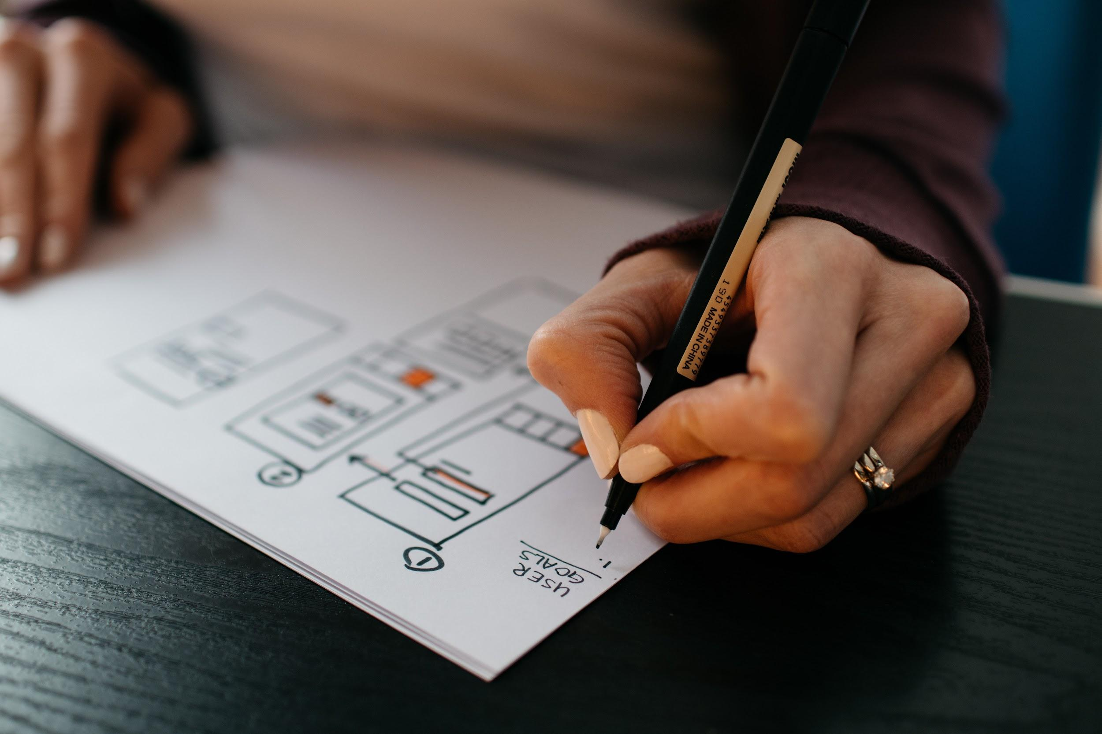
03
Prototype

Slide 17
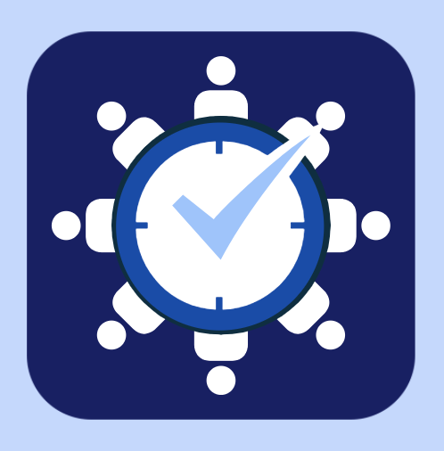
StudyWithUs: The Prototype
For students that need help focusing on their tasks, StudyWithUs is an app for smartphones that fully adapts to the user’s personality to keep them off other distracting apps, like social medias, create social accountability among friends, and offer rewards for sticking to their goals.
Notes:
Our organizational app for students that need help focusing on their tasks, StudyWithUs is an app for smartphones that fully adapts to the user’s personality to keep them off other distracting apps, like social medias, create social accountability among friends, and offer rewards for sticking to their goals.

Slide 18
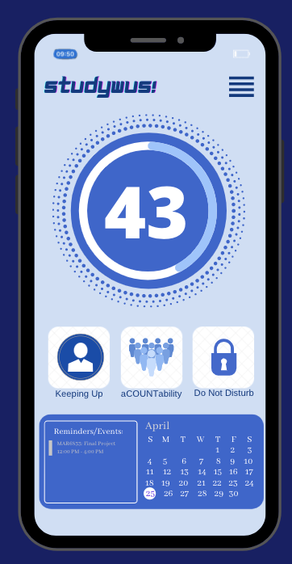
Reward
Earn out-of-app rewards for time spent using the app! Points per minute can be used to redeem food, textbook coupons, and other localized specials.
Menu Bar
Customize your profile and application look to your liking, search for features on the app,
Do Not Disturb
Stay productive and minimize distractions through ‘DND’ sessions by restricting the use of certain apps or time on screen through pop-up reminders.
Personalization
A personality test taken upon download tailors app features and notifications to you! As you use the app, it intuitively adapts and keeps us to your study habits.
Calendar
Easy to use and compatible calendar to keep track of your schedule, appointments, and give clarity about how to spend their time.
Social Accountability
Get to know what your friends are working on in real time through live status assignment updates. Users even have the option to share links to their working documents.
Home Screen | Personalization | Rewards | Do Not Disturb | Social Accountability
Notes:
StudyWithUs! has a combination of easy to use features that are easily accessible from the home screen. As shown here, our main features include rewards, personalization, social accountability, do not disturb, in addition to a an easy to use and compatible calendar to keep track of schedule and give clarity about how to spend time and menu bar for users to customize their app profile and features of the app to their likings.

Slide 19
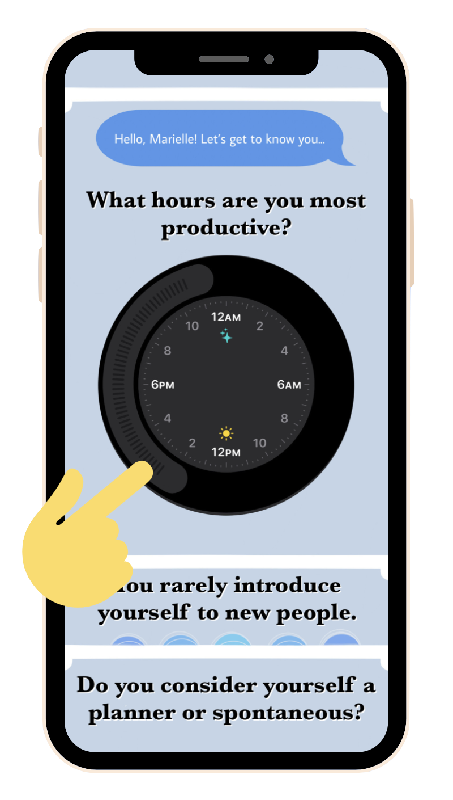
Personalization
Productivity features and notifications are tailored to you based on a personality test taken upon download and retaken every couple of months.
The app intuitively adapts based on your perceived behavior and personality.
Ex: As you use the app, it more accurately determines your productive hours and encourages you to study during that time frame.
Home Screen | Personalization | Rewards | Do Not Disturb | Social Accountability
Notes:
What separates our app from others like it on the market is that the app is specifically tailored to you. When you first download the app, it prompts you to take a personality test. As you use the app more, it intuitively begins to adapt to your perceived personality and behavior to encourage you to study more.
For example, this personality test asks you which hours you are most productive. As you use the app more, it more accurately determines which hours you actually study best and prompts you to study during that time.
The personality test also asks questions related to extraversion and how you approach tasks.

Slide 20
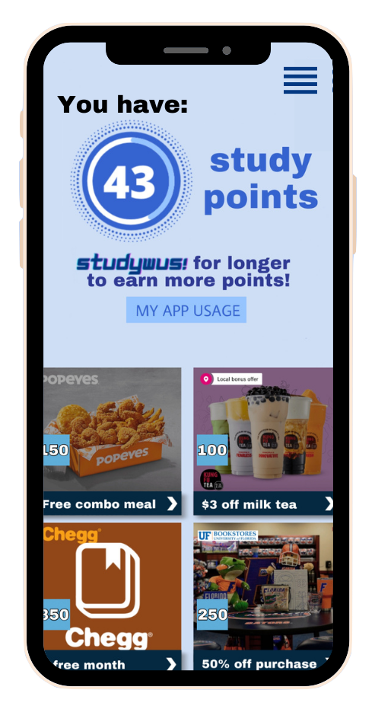
Rewards
Time spent using the app is converted into points that you can use to earn out-of-app rewards!
Rewards include food or drinks, coupons for textbooks or events, or even localized specials related to local businesses or universities.
Home Screen | Personalization | Rewards | Do Not Disturb | Social Accountability
Notes:
Our app actually rewards you for using it to study as well! Users are able to earn points which go towards out-of-app rewards, which include food or drinks, coupons for textbooks or services such as Chegg, and even potential specials related to universities or local businesses, such as a coupons for the UF Bookstore.

Slide 21
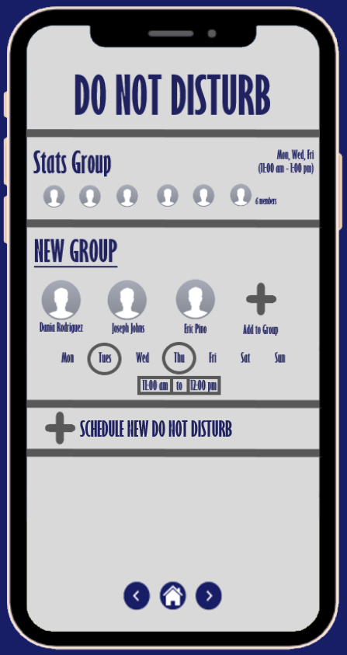
Do Not Disturb
Ability to make a do not disturb for a whole group
  Add as many group members as needed
  Keep everyone on task
  Increase productivity for the whole team
Ability to add multiple do not disturbs
  Add different settings for different groups
  Add different times and dates accordingly
Notifies when going into do not disturb
Home Screen | Personalization | Rewards | Do Not Disturb | Social Accountability
Notes:
The do not disturb feature has the optionality to be set for your whole team or study group. You can add as many people as needed to keep everyone on task and increase productivity for the whole team.
There is also the ability to set multiple do not disturbs, for different needs and times.
It also helps you by notifying you when it is turning on.

Slide 22
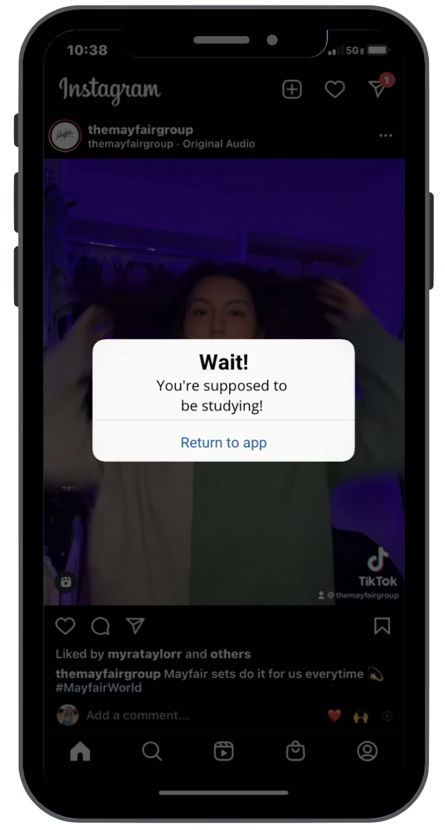
Notifications
When Do Not Disturb mode is on, for a group or for an individual:
Custom messages to keep you off selected apps
Must return to app in order to turn off Do Not Disturb before going on selected apps
Uses personalization quiz results to tailor messages to be effective for you
Home Screen | Personalization | Rewards | Do Not Disturb | Social Accountability
Notes:
When the user has Do Not Disturb on, they can select certain apps that they want to be able to use or restrict. If the user tries to go onto a restricted app during the Do Not Disturb session, a customized reminder pop-up will force the user to return to the app and disable Do Not Disturb before they can use all apps on their phone. You can add any app to the app menu shown above giving complete customization to the Do Not Disturb feature. The pop-ups will also be tailored to the user’s personality using the results from the personality tests.

Slide 23
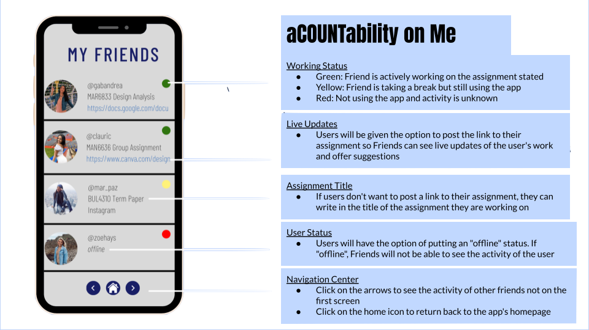
aCOUNTability on Me
Working Status
Green: Friend is actively working on the assignment stated
Yellow: Friend is taking a break but still using the app
Red: Not using the app and activity is unknown
Live Updates
Users will be given the option to post the link to their assignment so Friends can see live updates of the user's work and offer suggestions
Assignment Title
If users don't want to post a link to their assignment, they can write in the title of the assignment they are working on
User Status
Users will have the option of putting an "offline" status. If "offline", Friends will not be able to see the activity of the user
Navigation Center
Click on the arrows to see the activity of other friends not on the first screen
Click on the home icon to return back to the app's homepage
Home Screen | Personalization | Rewards | Do Not Disturb | Social Accountability
Notes:
Lastly, the social accountability feature allows users to see what their friends are working on in real time. The different color lights on the top right corner of your friend’s profile symbolizes a person’s working status: green being actively working on an assignment, yellow representing someone is using the app but taking a break from work, and red indicating that the person is not actively using the app.
People have the option to even share a link to the assignment they are working on so friends’ can offer suggestions or keep you accountable for making visual progress on an assignment..
However if someone does not want to share a link, they can also post the assignment title they are actively working on to motivate others to do the same.
Lastly, the navigation center on the bottom of the screen allows users to see more updates of other friends’ working statuses. Use the right and left arrows to see all available profiles (of your friends). And hit the home button on the center of the screen to return to the homepage.

Slide 24
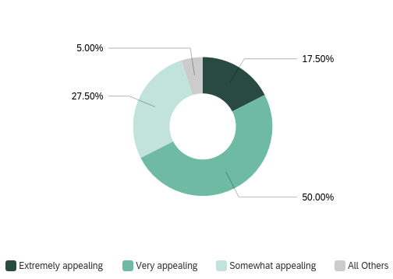
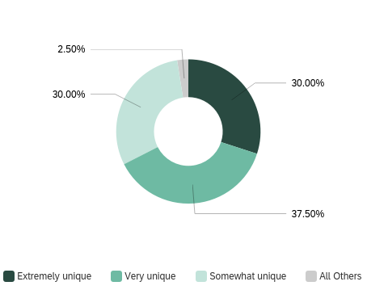
Survey Results
Appeal
Relative uniqueness
Notes:
To test our prototype, we conducted another survey. We had 40 respondents, 36 of which are between the ages of 18-22 and over half were female.
We first asked about initial reactions of our product; 90% of respondents had a somewhat positive or extremely positive initial reaction and 97.5% of respondents felt that the product was either somewhat, very, or extremely unique relative to similar apps on the market. The majority of respondents also found our prototype to be very appealing (50% responded very appealing, and 17.5% responded extremely appealing as shown in the pie chart above) and like the product overall. 45% said they like the idea a great deal, 42.5% like it a little, and only 2.5% somewhat dislike it.

Slide 25
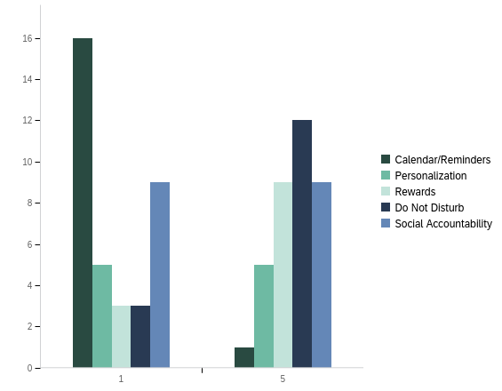
Survey Results
Notes:
We again asked respondents to rank specific attributes of productivity apps in order of relevance to their personal wants and needs. The results were similar to our first survey as most respondents feel that a calendar is the most important and do not disturb and rewards were some of the least important.

Slide 26
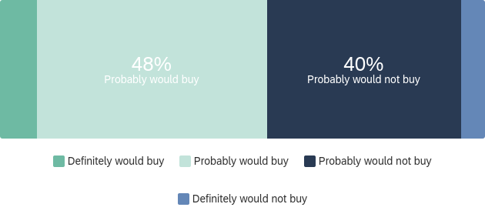
Survey Results
Notes:
Despite respondents viewing the prototype as unique and appealing, 45% of respondents said that they would probably not buy or definitely not buy this product. During our interviews, we concluded that the best pricing model would be a subscription model. In our survey, when asked about price, the majority of respondents said that if the app were available as a subscription-based application, they would value it at around $0.99 to $1.99 a month. No one responded that it would be worth more than $3.99 a month.

Slide 27

04
Go/No-Go
Notes:
After the analysis of our final survey results, my team and I were able to reflect upon whether or not we should continue with the marketing of our app StudyWithUs.

Slide 28
Go/ No Go Decision
Analyzing final survey results
Positive Feedback: Ratings of relevance, uniqueness, and attractiveness of product is ALL over 80%
Negative Feedback: Will not pay a premium price ($1.99+) for the app, only about 50% of participants said they will purchase the product
1
2
3
How our potential product pivoted since our initial concept
Elimination of common features on productivity apps like reminders and files component
Focus only on the 4 differentiating factors: Personalization, Rewards, Smart Do Not Disturb, Social Accountability
Add partnerships with reward companies
Final Go/ No Go Decision
Due to the positive response rate toward the product’s relevance, uniqueness, and attractiveness, our team has decided to move forward and proceed with a market test of StudyWithUs.
Notes:
Before making this decision it is important to note that we did pivot from our original concept of the app. We originally wanted this application to be a one stop shop that combines all the unique features of various productivity applications while also adding our own new features we came up with while conducting our empathic design. However, after several group interviews and concept testing sessions, our biggest feedback was that our app felt too busy.
So instead we decided to only focus on the 4 wholly-new features of personalization quizzes, reward systems, smart do not disturb and Social Accountability.
After cleaning up our prototype, we released a final survey to gauge interest in our product. Although there was some negative feedback like consumers’ unlikeliness to pay anything over 2 dollars for our product and only half the responses saying they would purchase the product. We believe the positive results of the survey outweighed the bad.
After extensive analysis, our team decided to move forward and proceed with a market test of StudyWithUs because over 80% of respondents highly rated relevance, uniqueness and attractiveness of our product.

Slide 29
Marketing Plan
Product
Price
Value Proposition: StudyWithUs provides users with the ability to start their productivity journey or enhance their productivity through the implementation of 4 unique features (below). The app’s consolidation and simple navigation caterers to people new to productivity apps.
4 Key Attributes:
Personalization Quizzes Smart Do Not Disturb
Reward System Social Accountability
The consensus derived from concept testing interviews and surveys is that consumers’ would like a subscription payment plan.
Sources of Revenue::
User Subscription Fee: 1st month free → $0.99/month after trial period
Advertisements (banner ads)
Partnerships with the companies offering “rewards” on the application
Place
Promotion
Target Customer: College students ages 21-26
Our team plans to first release our app in major cities where state universities are located. We will first market test the app in Gainesville, Florida.
We plan to partner up with the University, student organizations and educational resources like Study Edge to reach our target market.
Communicating Value
Brand ambassadors and social media advertisements (Instagram, Facebook, LinkedIn)
Sponsoring student organizations/clubs
Release
My team will register for Apple’s developer program and then submit our app to be reviewed to be available in Apple’s App Store
Notes:
After making this decision, we developed a marketing plan.
First of all, our product’s value proposition is that StudyWithUs provides users with the ability to start their productivity journey or enhance their productivity through the implementation of 4 unique features: Personalization Quizzes, Reward Systems, Smart Do Not Disturb, and Social Accountability. The features were all uniquely crafted to adapt to the common behaviors witnessed during our empathic design like phone usage and studying in groups. These 4 key attributes coupled with simple navigation features caters to people who are new to productivity apps.
As for pricing, most participants in the concept testing sessions agreed that they would like a subscription plan so they can choose when they use the app. And if the student wasn’t taking classes a certain semester, they wouldn’t have to pay for the app during that time period. To increase interest, we also decided that the first month will be offered for free. For subsequent months it will be $0.99/month which was the common price for similar apps in the market. Another source of revenue to offset the costs of maintenance with our app will be through banner advertisements and partnerships with companies in our reward system program.
Next, the place. Our target customer will be college students ages 18-26. We will first release our app in major cities containing a large state university. We decided to first test our app in Gainesville, FL. Here we will partner up the University, student orgs and educational resources through sponsorships to reach our target market.
And to end it off, promotion. Based on our target customers being college students, we plan to penetrate social media outlets popular to this group like Instagram, Facebook and LinkedIn. We will also use brand ambassadors from different universities to promote the app. We will sponsor certain student clubs so we have direct communication to students on campus. And lastly, we plan to release this app on both the Apple Store and Google Play.
We are excited to launch StudyWithUs soon and can’t wait to develop the app even further after test marketing. Thank you for listening.

